Slide 1
DS PROJECT REPORT
Submitted By:
Utkarsh Kashyap 17103193
Nipun Varshney 17103182
Anika Sindwani 17103183

Slide 2
LIST OF DATA STRUCTURES USED
Linked List
Arrays
File Handling

Slide 3
IMPORTANT FUNCTIONS
Can store information of users, products and other items
Has secure Login and Signup page
Based on working model of various shopping sites such as Flipkart, Amazon etc.

Slide 4
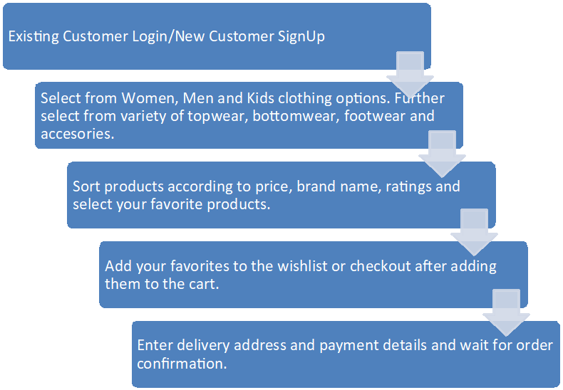
FLOWCHART

Slide 5
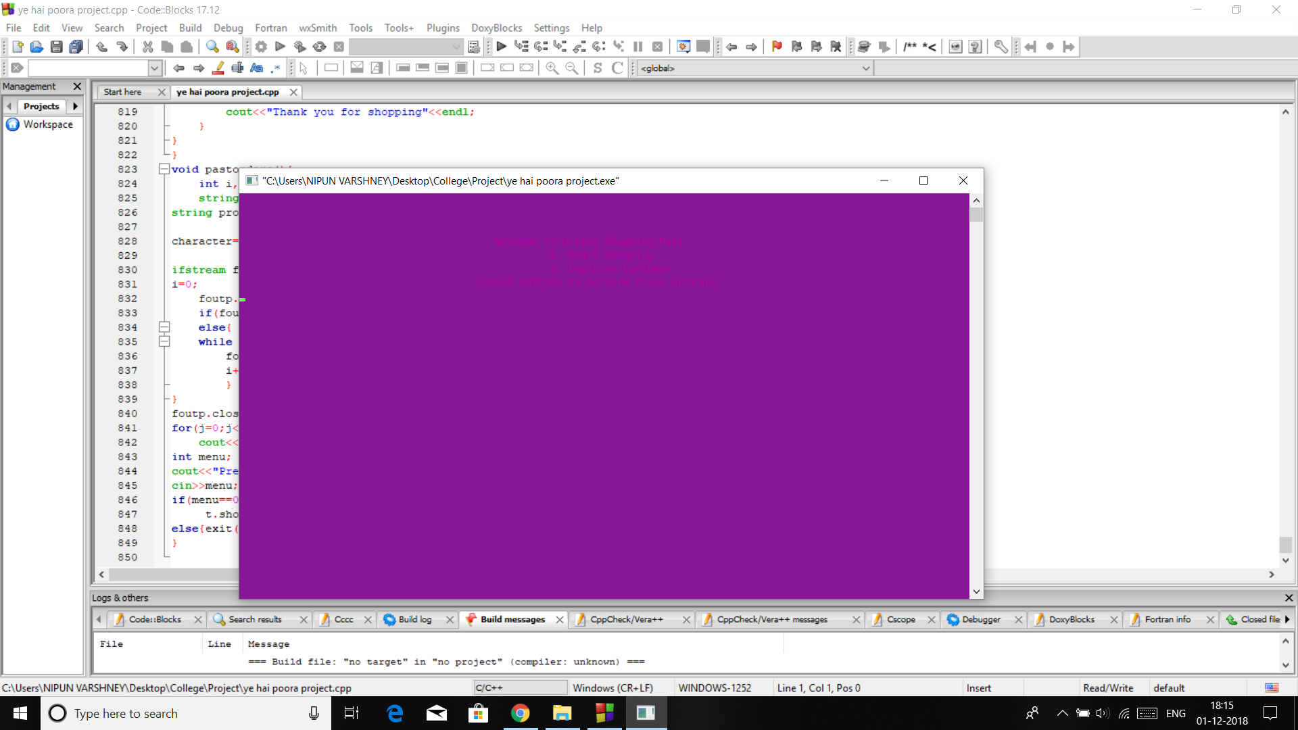
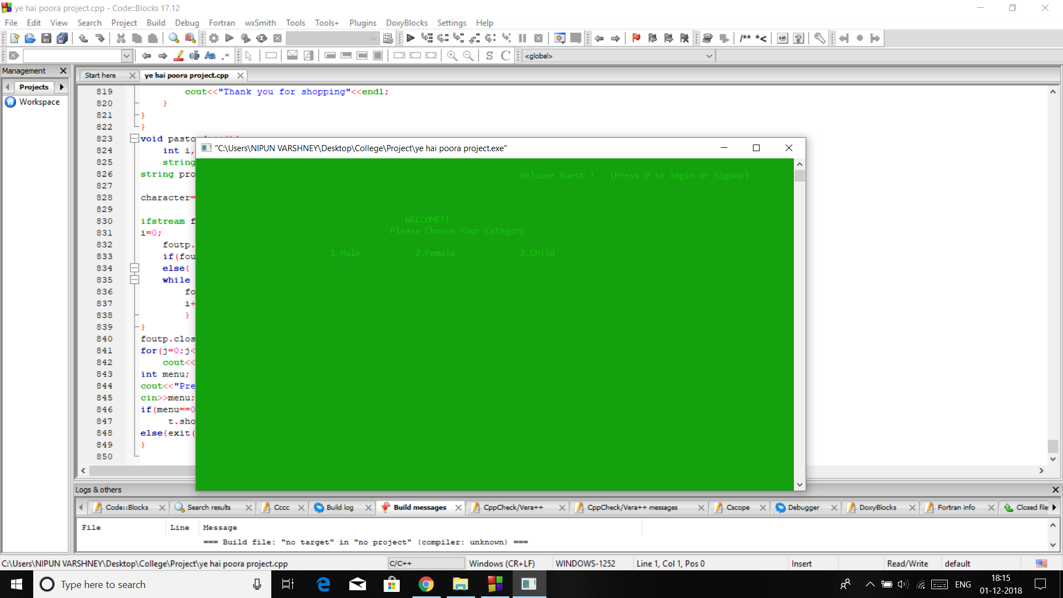
SCREENSHOTS

Slide 6
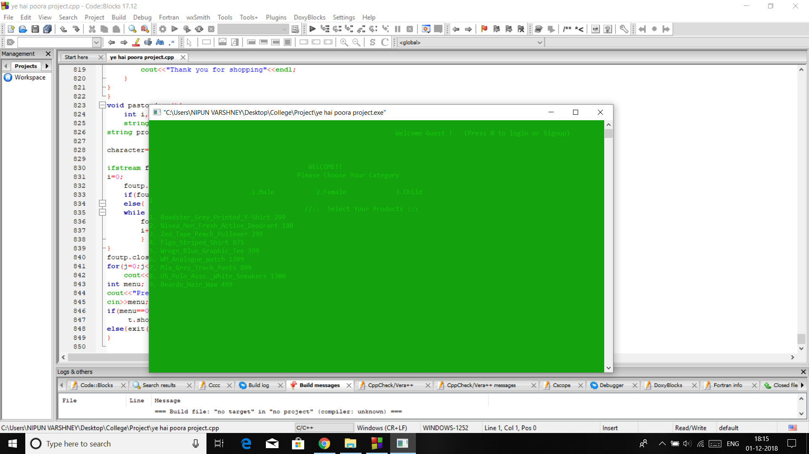

SCREENSHOTS

Slide 7


SCREENSHOTS

Slide 8
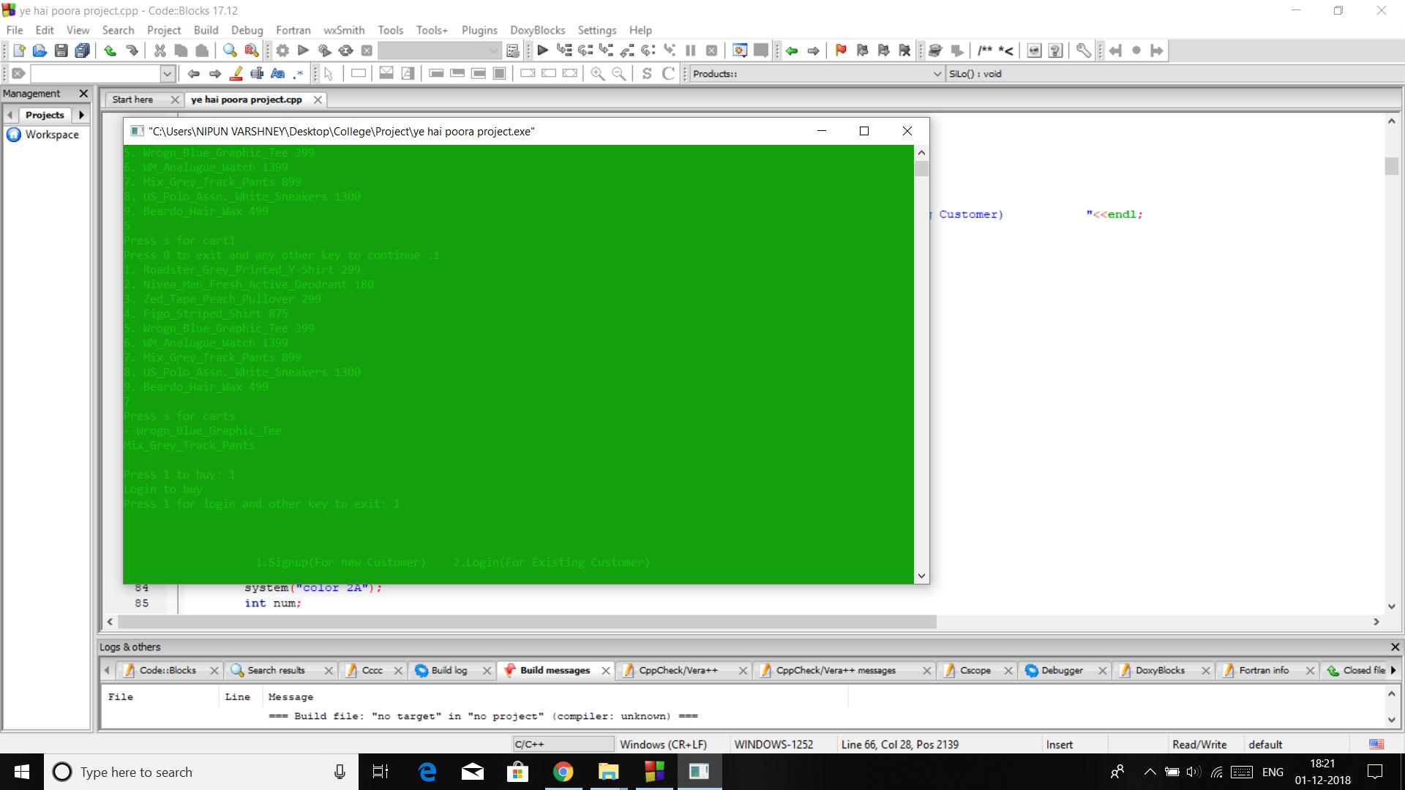
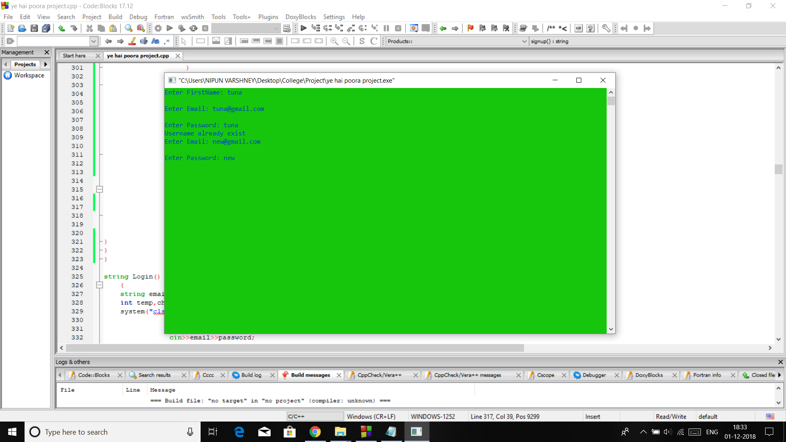
SCREENSHOTS

Slide 9
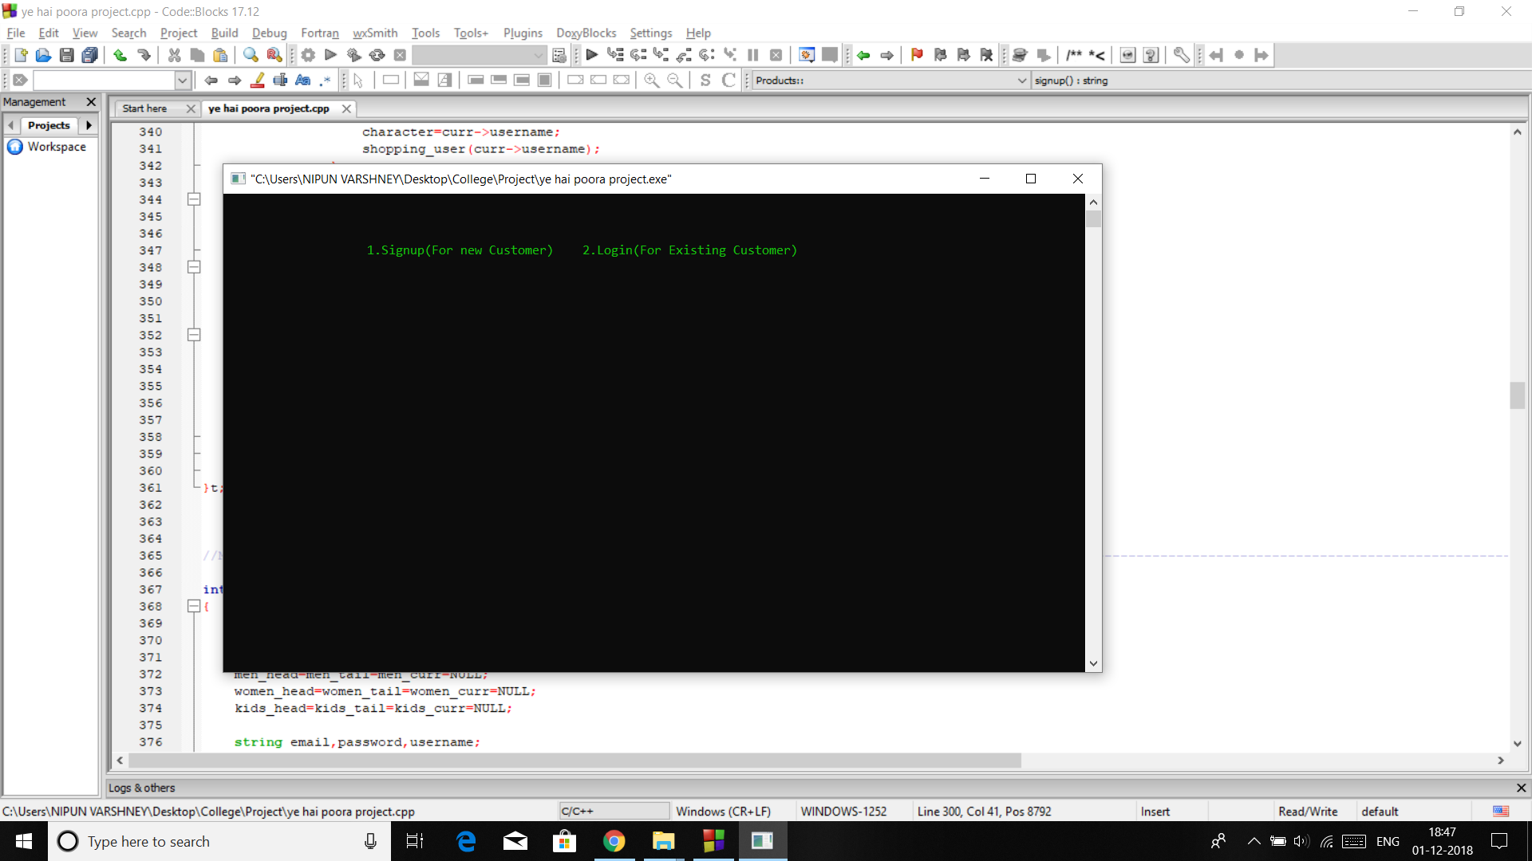
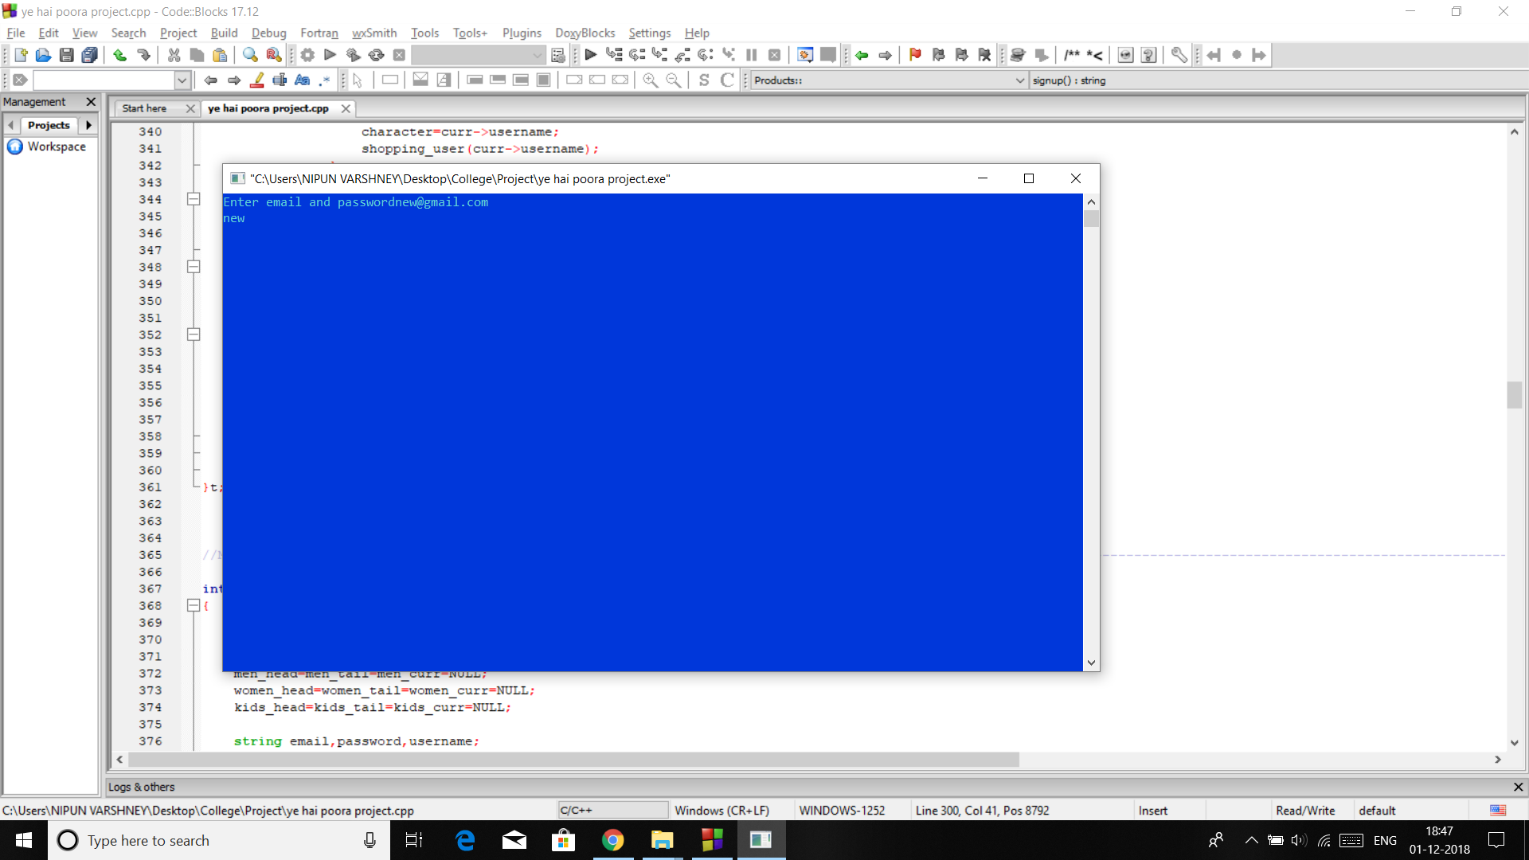
SCREENSHOTS

Slide 10
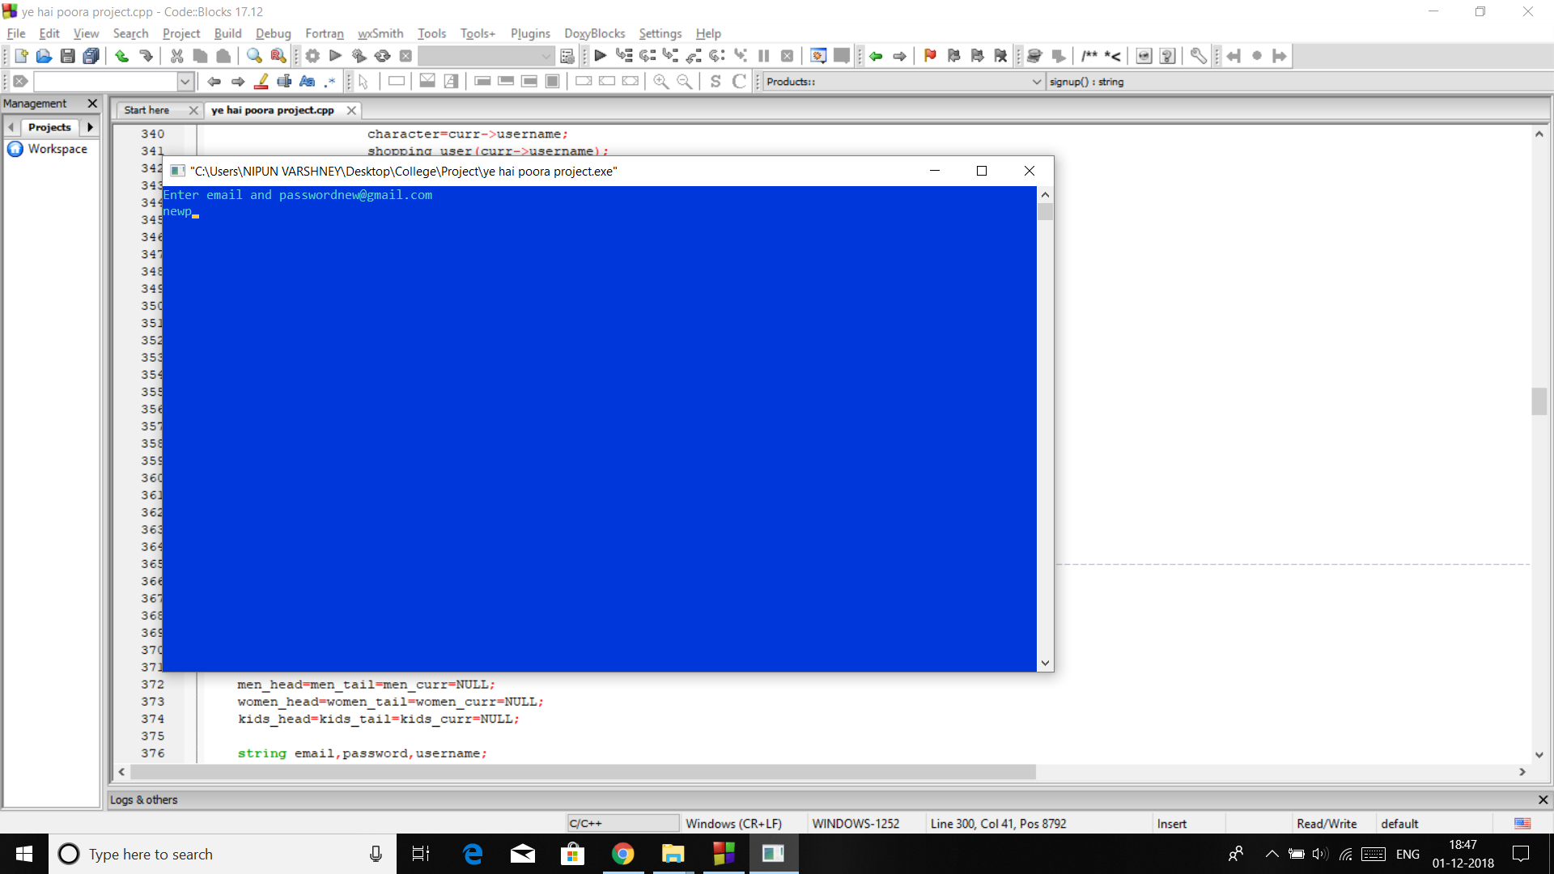
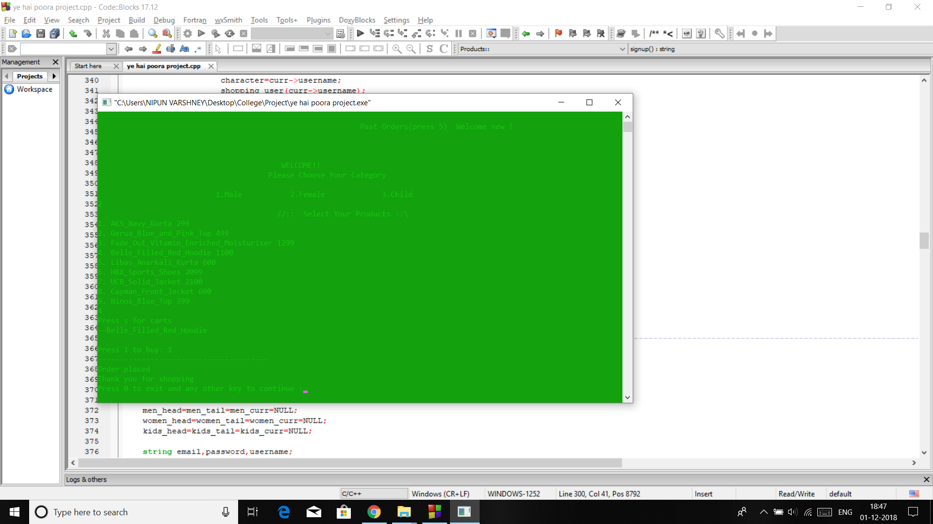
SCREENSHOTS

Slide 11

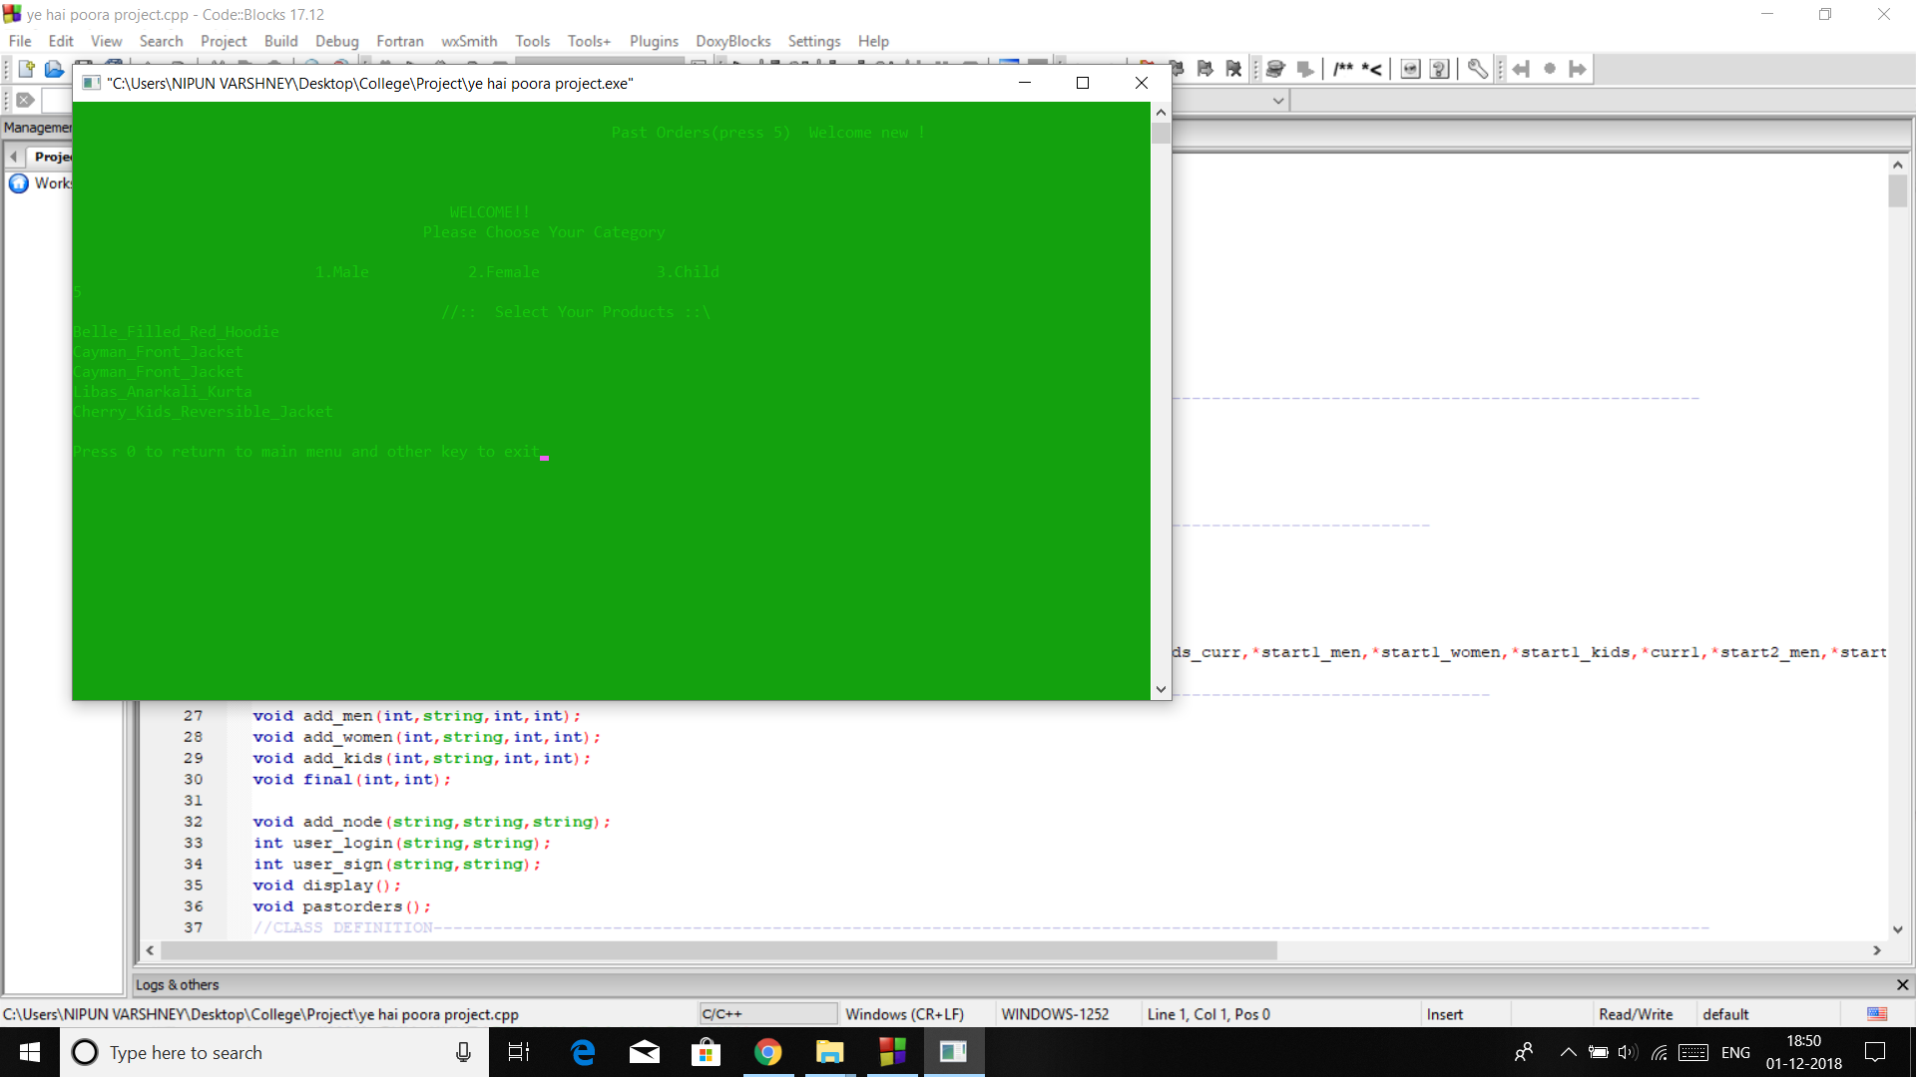
SCREENSHOTS

Slide 12
GROUP MEMBER WISE TASK DISTRIBUTION
Anika Sindwani : Main Idea of the project and (17103183) workflow designing.
Nipun Varshney (17103182): File Handling Work.
Utkarsh Kashyap (17103193): Menu Design and Appearance Settings.

